Slide 1

Paging Hardware With TLB
Operating System Concepts

Slide 2
Effective Access Time
Associative Lookup = ε time unit
Assume memory cycle time is 1 microsecond
Hit ratio – percentage of times that a page number is found in the associative registers; ration related to number of associative registers.
Hit ratio = α
Effective Access Time (EAT)
EAT = (1 + ε) α + (2 + ε)(1 – α)
= 2 + ε – α
Operating System Concepts

Slide 3
Example-1 : Find the Average Effective Memory Access Time when 80 percent is the hit ratio and it take 20 nanoseconds to search TLB and 100 nanoseconds to access memory (Hint : then take 120 nanoseconds to access mapped memory). In Case of Miss, It also takes 100 nanosecond to access frame number. The Total time taken in case of Miss is (20 + 100 + 100 = 220 nanosecond)
Solution:
Average Access Time = 0.80 * ( 20+ 100) + 0.20 * ( 20 + 100 + 100)
= 0.80 * 120 + 0.20 * 220
= 96 + 44 = 140 nanoseconds
Operating System Concepts

Slide 4
Example:-2
Consider a paging hardware with a TLB. Assume that the entire page table and all the pages are in the physical memory. It takes 10 milliseconds to search the TLB and 80 milliseconds to access the physical memory. If the TLB hit ratio is 0.6, the effective memory access time (in milliseconds) is _________.
Solution:
Effective Access Time =
hit ratio * (TLB access time + Main memory access time) +
(1 – hit ratio) * (TLB access time + 2 * main memory time)
= 0.6*(10+80) + (1-0.6)*(10+2*80)
= 0.6 * (90) + 0.4 * (170)
= 122
Operating System Concepts

Slide 5
Memory Protection
Memory protection implemented by associating protection bit with each frame.
Valid-invalid bit attached to each entry in the page table:
  “valid” indicates that the associated page is in the process’ logical address space, and is thus a legal page.
  “invalid” indicates that the page is not in the process’ logical address space.
Operating System Concepts

Slide 6
An address space is specified by 24 bits and the corresponding memory space by 16 bits. How many words are there in the address space. How many words are there in the memory space. If a page consists of 2K words, how many pages and blocks are there in the system?
Operating System Concepts

Slide 7
Q. The logical address space in a computer system consists of 128 segments each segment can have up to 32 pages of 4K words In each. Physical memory
consists of 4K block of 4K words In each. Formulate the logical and physical address formats.
Operating System Concepts

Slide 8
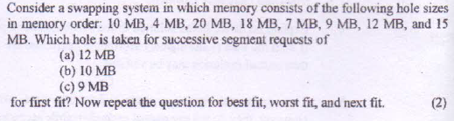
Operating System Concepts

Slide 9


Operating System Concepts

Slide 10
A Computer provides each process with 65536 bytes of address space divided into pages of 4096 bytes. A particular program has instruction of 32768 bytes , a data size of 16386 bytes and a stack size of 15870 bytes. Will this program fit in the address space? If the page size were 512 bytes , would it fit? Remember that a page may not contain part of two different segments.
Operating System Concepts

Slide 11
A CPU generates 32-bit virtual addresses. The page size is 4 KB. The processor has a translation look-aside buffer (TLB) which can hold a total of 128 page table entries and is 4-way set associative. The minimum size of the TLB tag is:
11 bits (B) 13 bits ( c ) 15 bits ( D ) 20 bits
Answer Size of a page = 4KB = 2^12
Total number of bits needed to address a page frame = 32 – 12 = 20
If there are ‘n’ cache lines in a set, the cache placement is called n-way set associative.
Since TLB is 4 way set associative and can hold total 128 (2^7) page table entries, number of sets in cache = 2^7/4 = 2^5.
So 5 bits are needed to address a set, and
15 (20 – 5) bits are needed for tag.
Operating System Concepts

Slide 12
Solution of the problem mentioned in previous slide
A 24-bit address is required to cover 2²⁴-bytes physical address space . Since pages , and therefore page frames ,are 2¹⁰ bytes, the last bits in the physical address specify the page offset .The remaining 14 bits specify the page frame number.
hitendra.garg@gmail.com

Slide 13
Memory Protection
Memory protection implemented by associating protection bit with each frame.
Valid-invalid bit attached to each entry in the page table:
  “valid” indicates that the associated page is in the process’ logical address space, and is thus a legal page.
  “invalid” indicates that the page is not in the process’ logical address space.
Operating System Concepts

Slide 14

Valid (v) or Invalid (i) Bit In A Page Table
Operating System Concepts

Slide 15
Suppose, memory space is partitioned into 8 fixed size slots of 8 MB each. Assume 8 processes are currently requesting memory usage with sizes indicating as [2 MB, 4 MB, 3 MB,7 MB, 9 MB, 6 MB, 1 MB, 8 MB]. Calculate the internal fragmentation if Single partition is allocated to one process only. Also Calculate internal partition when multiple partition can be allocated to one process only.
Operating System Concepts

Slide 16
Virtual Memory
Main Reference from chapter 9 of “Operating System Concepts” by Galvin 5th and 8th Edition.
hitendra.garg@gmail.com

Slide 17
Chapter 9: Virtual Memory
Background
Demand Paging
Page Replacement && its algorithms.
Allocation of Frames
Thrashing
Already have some flavor of Virtual Memory during OVERLAYS.
hitendra.garg@gmail.com

Slide 18
Objectives
To describe the benefits of a virtual memory system
To explain the concepts of demand paging, page-replacement algorithms, and allocation of page frames.
hitendra.garg@gmail.com

Slide 19
Virtual Memory
It is an illusion of memory which is different from the “real” memory, i.e, RAM, existing in a system. A user or his/her application program sees only the virtual memory. The memory may be much larger in size than the real memory. The kernel implements the illusion using a combination of hardware and software means.
The basic of a virtual memory (VM) implementation is noncontiguous memory allocation. Noncontiguous memory allocation permits part of a program to be loaded into 2 or more non-adjacent areas of memory for execution. This technique reduces the problem of memory fragmentation since a free area of memory can be reused even it is not large enough to hold an entire program.
Either the case of paging or segmentation or paged segmentation, it is required that whole of the process must be in main memory which is not the case in virtual memory.
hitendra.garg@gmail.com

Slide 20
Virtual Memory
Another important aspect of a VM implementation is an arrangement which enables a program to execute even when its entire code and data are not present in the memory.
The basic idea is to load only the required portions of the code and data in memory at any time. This arrangement enables execution of a program whose side exceeds the size of the memory. The kernel uses this idea to reduce memory allocation to programs in general-that is, even programs which can fit into memory are not loaded fully into memory. This strategy increases the number of programs which can be accommodated in memory even further.
hitendra.garg@gmail.com

Slide 21
Background
Virtual memory – separation of user logical memory from physical memory.
  Only part of the program needs to be in memory for execution
  Logical address space can therefore be much larger than physical address space
  Allows address spaces to be shared by several processes
  Virtual memory can be implemented via:
  Demand paging [bring pages of the process from the secondary storage device onto the RAM (Physical memory) when required(on demand)]
  Demand segmentation [bring segments of the process from the secondary storage device onto the RAM (Physical memory) when required(on demand)]
hitendra.garg@gmail.com

Slide 22
Virtual Memory
Virtual memory is a technique that allows a process to execute in the main memory space which is smaller than the page size.
Only a part of the process needs to be loaded in the main memory for it to execute.
Sharing of address space among several processes.
hitendra.garg@gmail.com

Slide 23
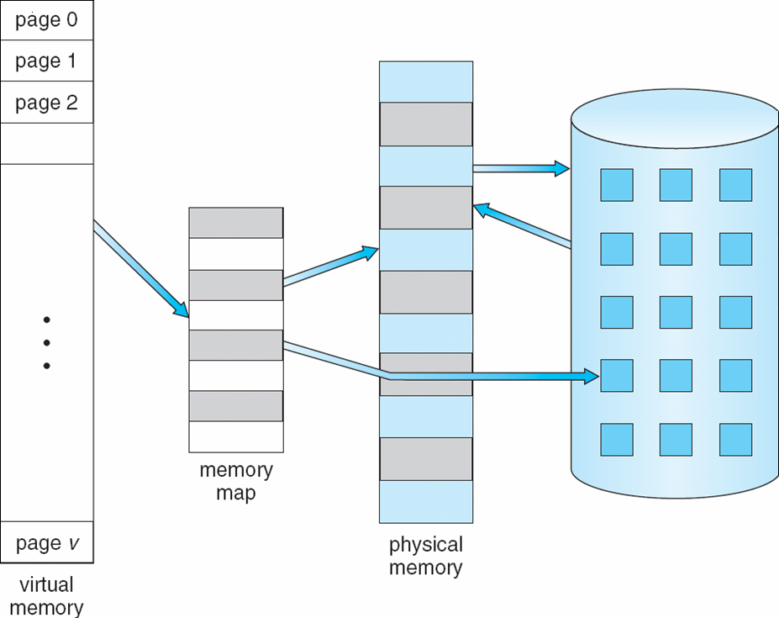
Virtual Memory That is Larger Than Physical Memory
⇒
hitendra.garg@gmail.com

Slide 24
Demand Paging
Bring a page into memory only when it is needed
  Less I/O needed[All of the features of S/W is rarely used i.e., bring into main memory, for example exception handling.]
  Less memory needed
  Faster response [Lesser response time.]
  More users[High Degree of multiprogramming]
hitendra.garg@gmail.com

Slide 25
Demand Paging
  Page is needed ⇒ reference to it
  During translation from logical to physical address translation
  invalid reference ⇒ abort[demanded page by the process is not in process address space, it is not the part of its address space.]
  not-in-memory ⇒ Page Fault ⇒ bring to memory[demanded page by the process is valid and is in process address space, but not presently available in primary memory[RAM]. Trap for the page fault[ Due to Trap , common service code will execute and check whether it is due to invalid reference or due to not-in-memory].[Page Fault ?].]
No free frame ⇒Swapping[out and in][Page Replacement ?]
Lazy swapper – never swaps a page into memory unless page will be needed
  Swapper that deals with pages is a pager
hitendra.garg@gmail.com

Slide 26
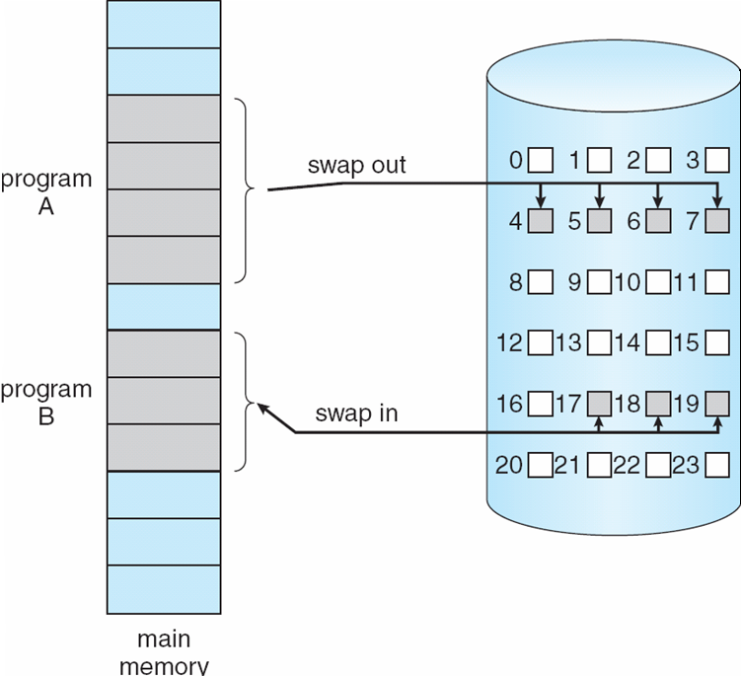
Transfer of a Paged Memory to Contiguous Disk Space[Swapping]
hitendra.garg@gmail.com

Slide 27
Valid-Invalid Bit
With each page table entry a valid–invalid bit is associated
(v ⇒ in-memory, i ⇒ not-in-memory)
Initially valid–invalid bit is set to i on all entries
During address translation, if valid–invalid bit in page table entry is I ⇒ page fault
Example of a page table snapshot:
Frame #
valid-invalid bit
v
v
v
v
i
….
i
i
page table
hitendra.garg@gmail.com

Slide 28
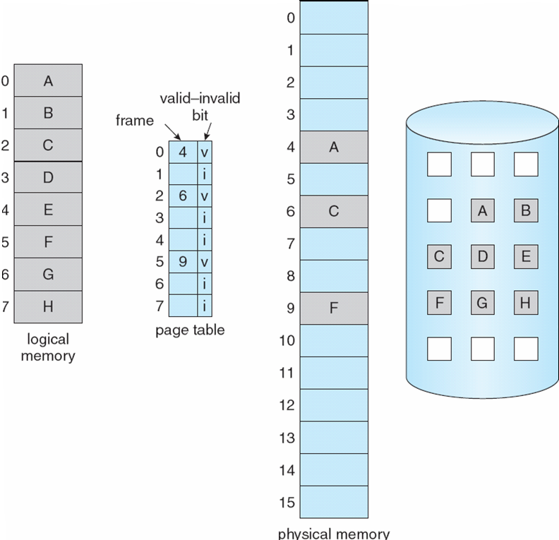
Page Table When Some Pages Are Not in Main Memory
hitendra.garg@gmail.com

Slide 29
Page Fault
If there is a reference to a page, first reference to that page will trap to operating system:
page fault
Operating system looks at another table to decide:
  Invalid reference ⇒ abort[trap to OS ⇒abort process ]
  Just not in memory ⇒ page fault ⇒ service page fault
Get empty frame
Swap page into frame
Reset tables
Set validation bit = v
Restart the instruction that caused the page fault
hitendra.garg@gmail.com

Slide 30

Steps in Handling a Page Fault
hitendra.garg@gmail.com

Slide 31
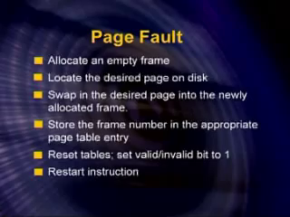
Steps in Handling a Page Fault/Servicing the Page Fault
hitendra.garg@gmail.com

Slide 32
Performance of Demand Paging
[Contribution Of Page Fault]
Page Fault Rate 0 ≤ p ≤ 1.0
  if p = 0 no page faults
  if p = 1, every reference is a fault
hitendra.garg@gmail.com

Slide 33
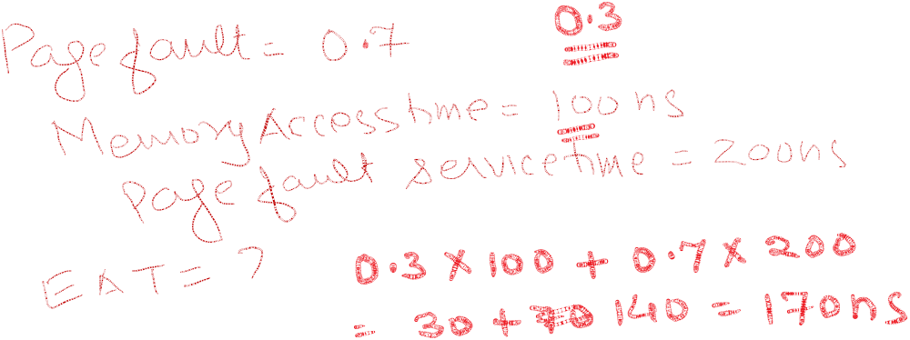
Performance of Demand Paging
[Contribution Of Page Fault]
Effective Access Time (EAT)
EAT = (1 – p) x memory access
+ p (page fault service time i.e, time needed to service the page fault )
hitendra.garg@gmail.com

Slide 34
Performance of Demand Paging
[Contribution Of Page Fault]
Effective Access Time (EAT)
EAT = (1 – p) x memory access
+ p (page fault overhead
+ swap page out
+ latency time
+ swap page in
+ restart overhead
)
Page-fault service time
hitendra.garg@gmail.com

Slide 35
Performance of Demand Paging
[Contribution Of Page Fault]
Memory Access Time =100 nanoseconds
Page Fault Service Time =25 milliseconds
T_{effective}=Effective Access Time=(1-p)*100 +p*(25 milliseconds)
=(1-p)*100 +p*(25000000)
= 100 + (24999900 *p)
Effective Access Time is directly proportional to the page fault rate “p”
hitendra.garg@gmail.com

Slide 36
Page Replacement Algorithms
To choose the victim page[right now discussion is on local replacement only]
Want lowest page-fault rate[means choosing a victim that should not give rise to page fault itself.]
Evaluate algorithm by running it on a particular string of memory references (reference string) and computing the number of page faults on that string
In all our examples, the reference string is
1, 2, 3, 4, 5, 3, 4 , 1, 6, 7, 8, 7, 8, 9, 5, 4, 5, 4, 4
Number of frames allocated to this corresponding process =4
hitendra.garg@gmail.com

Slide 37

Page Replacement Algorithms
In all our examples, the reference string is
1, 2, 3, 4, 5, 3, 4 , 1, 6, 7, 8, 7, 8, 9, 5, 4, 5, 4, 4
Number of frames allocated to this corresponding process =4
1 2 3 4 5 3 4 1 6 7 8 7 8 9 5 4 5 4 4
hitendra.garg@gmail.com

Slide 38


Page Replacement Algorithms
In all our examples, the reference string is
1, 2, 3, 4, 5, 3, 4 , 1, 6, 7, 8, 7, 8, 9, 5, 4, 5, 4, 4
Number of frames allocated to this corresponding process =4
1 2 3 4 5 3 4 1 6 7 8 7 8 9 5 4 5 4 4
hitendra.garg@gmail.com

Slide 39


Page Replacement Algorithms
In all our examples, the reference string is
1, 2, 3, 4, 5, 3, 4 , 1, 6, 7, 8, 7, 8, 9, 5, 4, 5, 4, 4
Number of frames allocated to this corresponding process =4
1 2 3 4 5 3 4 1 6 7 8 7 8 9 5 4 5 4 4
hitendra.garg@gmail.com

Slide 40
Page Replacement Algorithms
In all our examples, the reference string is
1, 2, 3, 4, 5, 3, 4 , 1, 6, 7, 8, 7, 8, 9, 5, 4, 5, 4, 4
Number of frames allocated to this corresponding process =4
1 2 3 4 5 3 4 1 6 7 8 7 8 9 5 4 5 4 4
hitendra.garg@gmail.com

Slide 41

Graph of Page Faults Versus The Number of Frames Allocated to a Process.
More the number of free frames allocated to a process, less and less is going to be a page fault rate.
hitendra.garg@gmail.com

Slide 42
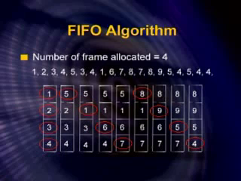
FIFO ALGORITHM
hitendra.garg@gmail.com

Slide 43
First-In-First-Out (FIFO) Algorithm
In previous slide , no pre paging is done.
In previous slide , with 4 allocated frames to a corresponding process , 12 page fault occurs.
Belady’s Anomaly: more frames ⇒ more page faults
Belady’s Anomaly: more memory ⇒ more page faults; [Not Logical]
Not in all Page Replacement Algorithms but found in FIFO ; that is why FIFO is rarely used.
“The page fault frequency of a program increases as its memory allocation is increased.”
“For some Page Replacement Algorithms , the page fault rate may increase as the number of allocated frames increases.”
hitendra.garg@gmail.com

Slide 44
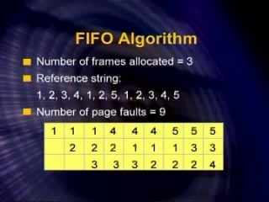
Example Depicting Belady’s Anomaly
hitendra.garg@gmail.com

Slide 45
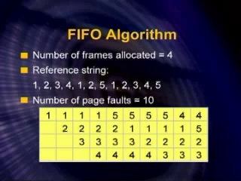
Example Depicting Belady’s Anomaly
hitendra.garg@gmail.com

Slide 46
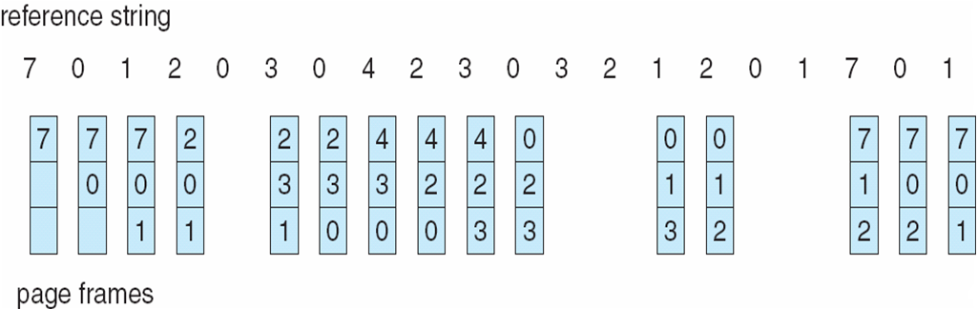
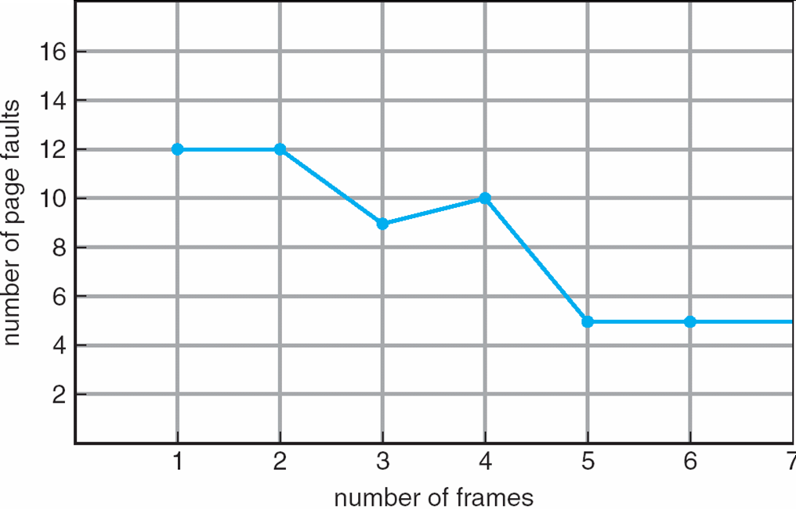
FIFO Illustrating Belady’s Anomaly
hitendra.garg@gmail.com

Slide 47
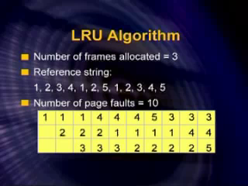
Example Depicting Belady’s Anomaly
hitendra.garg@gmail.com

Slide 48
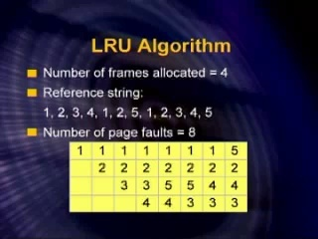
Example Depicting Belady’s Anomaly
hitendra.garg@gmail.com

Slide 49
Optimal Algorithm
Replace page that will not be used for longest period of time.
In case of tie in this algorithm, we use FIFO.
Best Algorithm, but not practical and implementable[Why ???].
But how will you predict the future ???[The pages and the sequences required in the future????]. We will know the requirements only when this process is executed.
How do you know this?
Used for measuring how well your algorithm performs[served as a bench mark.].
hitendra.garg@gmail.com

Slide 50
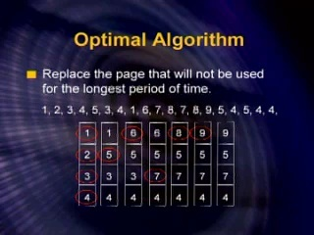
Optimal Algorithm [Page Fault=9 in this case]
hitendra.garg@gmail.com

Slide 51
Least Recently Used (LRU) Algorithm
Replace the page that has not been used for the longest period of time.
In optimal move forward towards future to check future references to find the page[victim to be replaced] which will be called/used in the last while in LRU move backward towards past to find the page[victim to be replaced] which was called/used in the first among the pages still in the frames[main memory ] i.e. both are mirror image of each other.
Counter implementation
  Every page entry has a counter; every time page is referenced through this entry, copy the clock into the counter
  When a page needs to be changed, look at the counters to determine which are to change
hitendra.garg@gmail.com

Slide 52
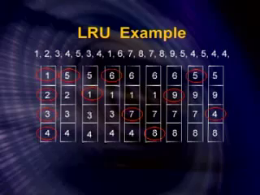
4 Free Frames; 12 Page Faults
hitendra.garg@gmail.com

Slide 53
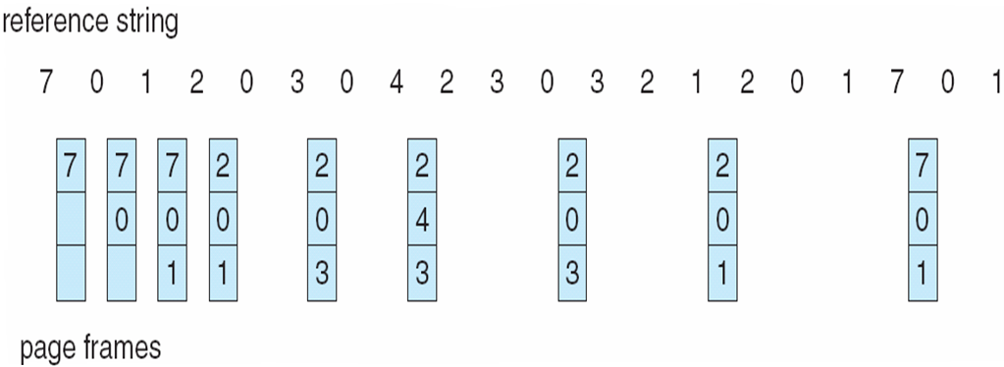
Optimal Page Replacement
hitendra.garg@gmail.com

Slide 54

Least Recently Used (LRU) Page Replacement
3 Free Frames; 12 page fault
hitendra.garg@gmail.com

Slide 55
Q. A virtual memory has an address space 18K words, a memory space has 9K words and block sizes of 3K words. The following reference generated by CPU
3 4 2 6 4 7 1 3 2 6 3 5 1 2 3
Show each page reference change if the replacement algorithm used is (a)FIFO (b)LRU © Optimal. Also state which algorithm is better on the basis of page fault?
3 4 2 6 4 7 1 3 2 6 3 5 1 2 3
Operating System Concepts

Slide 56
Q. A virtual memory has a page size of 1K words. There are eight pages
and four blocks. The memory page table contains the following entries:
Page Block/Frame
0 3
1 1
4 2
6 0
Make a list of all virtual addresses (In decimal) that will cause a page fault
if used by the CPU.
Operating System Concepts

Slide 57
Q. A virtual memory system has an address space of 8K words, a memory space
of 4K words, and page and block sizes of 1K words The following page reference changes occur during given time interval.
4 2 0 1 2 6 1 4 0 1 0 2 3 5 7
Determine the four pages that are resident In main memory after each page
reference change if the replacement algorithm used Is (a) FIFO; (b) LRU.
4 2 0 1 2 6 1 4 0 1 0 2 3 5 7
Operating System Concepts

